Slide 1

Lowe’s Campus Hackathon

Slide 2
Team Name: Wranglers
Theme Name: [Glide Shopping App]-A solution to help the customers find products in the store and help them navigate to the corresponding aisle/shelf. If there is a shopping list, provide the best shopping trip to complete the purchases
Team Members: Dharani,Edwin Joshua John, Brunda G

Slide 3
Solution Approach and Architecture:
Glide shopping is a mobile shopping platform that allows consumers to search, map and navigate to products in retail stores down to the sections of the aisles in which they are located. It's like Google Maps inside the store. With pre-planned digital shopping lists.
Augmented Reality and indoor Navigation is the base for the system. We make use of :
a map/CAD file of the store
a planogram
a product database
Indoor proximity and location through beacons, wifi triangulation, magnetics, inertial sensors, computer-vision on mobile devices and sensors, and visible light communication technologies that can work stand-alone, or all together in one SDK.

Slide 4
The solution leverages a building's existing Wi-Fi infrastructure and sensor information from mobile devices, such as data provided by the gyroscope, pedometer and compass, to deliver precise location information indoors without the need for any specialized hardware or additional infrastructure.
As customers approach the store they may receive a welcome message, and from there they can begin a search for a specific product. The app will do a lookup on a UPC and SKU database that is integrated with the glideshopping app. When aisle411 works with the retailer it will often clean up the product database in order to make it mappable. System obtains the store's available floor plans, which may vary depending on the number of typical building footprint options the retailer uses when opening a new store. After the search is completed, users are directed to the aisle where the product is located, but not to the individual shelf at this time.

Slide 5
Technology/Tool/Cloud Stack:
.DS_Store
android/build
android/dist
android/java-sources.txt
android/libs
ios/build
Xml version 1.0
apiversion: 3
architectures: armeabi-v7a x86

Slide 6
Hardware Specifications:
Hardware System Configuration:
Processor - Intel Core i5
Speed - 1.8 GHz
RAM - 256 MB (min)
Hard Disk - 10 GB
Software System Configuration:
Operating System - Windows 7 and more
Programming Language - java, xml version 1.0
Compiler - java Compiler

Slide 7
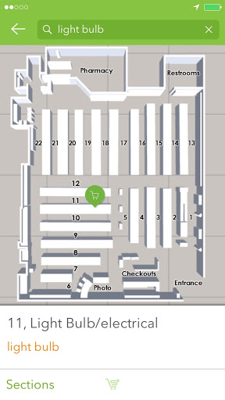
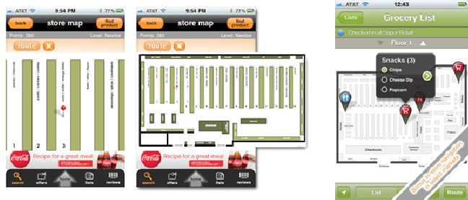
Demo - Prototype

Slide 8
Source code (zipped/ private GitHub repository) link: glide shopping.zip
<project name="glide-shopping" default="dist"> <description> Ant build script for Titanium Android module glide shopping </description> <property name="ti.module.root" location="${basedir}"/> <property file="build.properties" /> <!-- Make sure 'architectures' is in manifest file --> <property file="${ti.module.root}/manifest" prefix="manifest"/> <fail message="Missing required manifest key 'architectures'."> <condition> <not> <isset property="manifest.architectures"/> </not> </condition> </fail>
<fail message="Manifest key 'architectures' has no value."> <condition> <not> <length string="${manifest.architectures}" trim="true" when="greater" length="0"/> </not> </condition> </fail>

Slide 9
<!-- Copy documentation subdirectories --> <mkdir dir="${basedir}/documentation"/> <copy todir="${basedir}/documentation"> <fileset dir="${basedir}/../documentation"/> </copy> <!-- Copy example subdirectories --> <mkdir dir="${basedir}/example"/> <copy todir="${basedir}/example"> <fileset dir="${basedir}/../example"/> </copy> <!-- Copy assets subdirectories --> <mkdir dir="${basedir}/assets"/> <copy todir="${basedir}/assets"> <fileset dir="${basedir}/../assets"/> </copy> <!-- Copy license --> <copy todir="${basedir}" file="${basedir}/../LICENSE"/> <target name="cleancopy" description="Delete old copies"> <delete dir="${basedir}/documentation"/> <delete dir="${basedir}/example"/> <delete dir="${basedir}/assets"/> <delete file="${basedir}/LICENSE"/> </target> <import file="${titanium.platform}/../module/android/build.xml"/> </project>

Slide 10
Challenges Faced:
Hardware issues – Since AR has a bulky hardware it might be slightly expensive for the masses.
Fluctuations in magnetic field- Since the system depends on the magnetic field as well, this field will vary with any changes in the interior. Like using iron in the construction for a short period of time might impact the field and leads to less accuracy in location.

